Slide 1
Photography
Unit 3 – Section 2
Creating a Camera Obscura

Slide 2
Unit 3 – Camera Obscura
Section 2 – Creating a Camera Obscura

Slide 3
The big idea
Design implementation of custom camera obscura
Importance of creating a light proof environment
Analyze pinhole camera

Slide 4
Google Classroom Code
Photography
rhxkpt
Photography
7mdo2ur

Slide 5

Camera Obscura
Design a camera obscura “pinhole” camera
Be sure to consider the size of the photo you wish to take
This will emphasize how big your back cover will be
Be sure to create clean and crisp edges/corner to stop light from getting into your camera
Center your pinhole
Design your shitter or “flap”

Slide 6

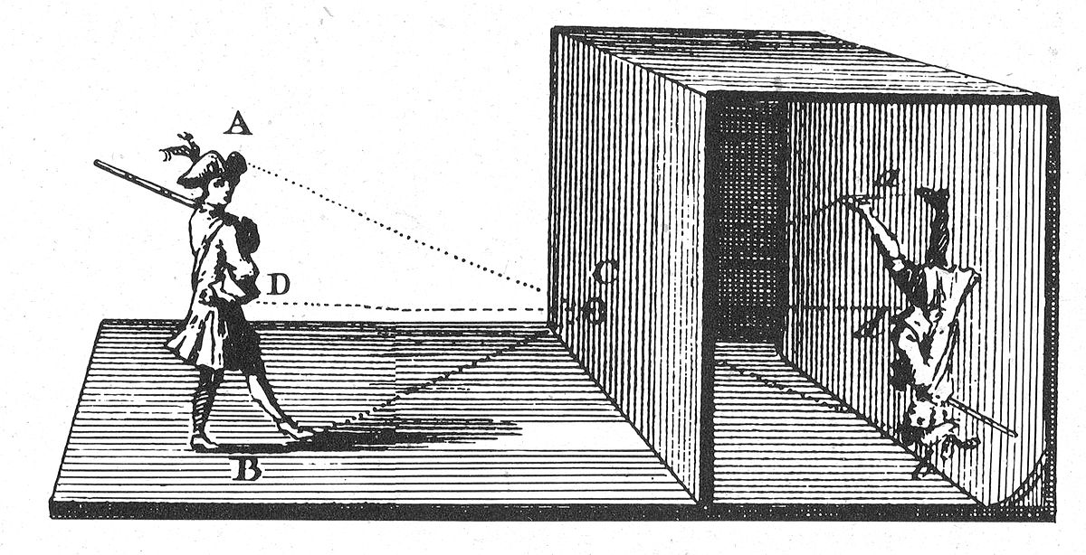

Law of Optics
Light rays reflect from a subject or scene and cross
When they reform on the new surface it is upside-down

Slide 7
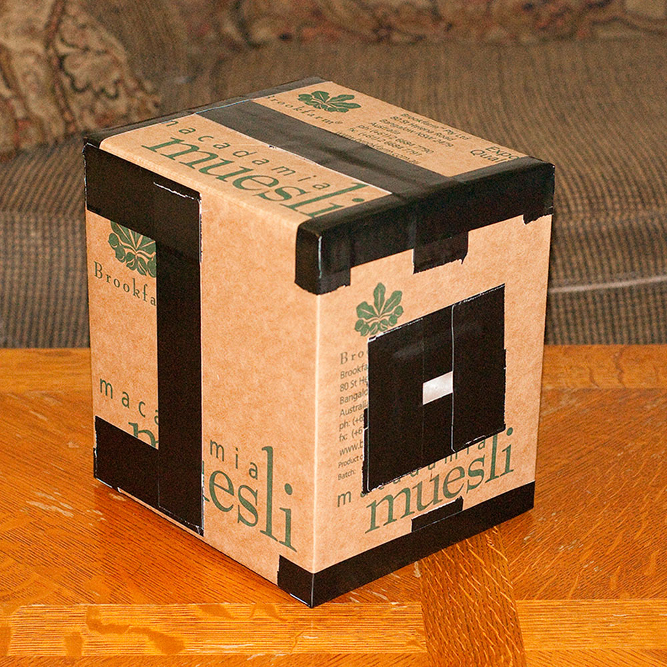

Slide 8
You don’t take a photograph, you make it.
Ansel Adams

